Slide 1
SQL Server 2000 Internals
Storage Concepts
Ramkumar Murugesan

Slide 2
SQL Server Storage Concepts
Data Storage Components
Data Pages – Exhaustive Study
How SQL Server stores Data
How SQL Server reads Data
Exercise

Slide 3
Next Section>>>
Data Storage Components
Topics…
Overview | Structure of a Database | Structure of a File | Structure of a Page | Types of Pages and Extents

Slide 4
Overview of Components
SQL Server maps a database over a set of operating-system files
  Primary data files
  Secondary data files
Log files that hold the log information to recover the database
Data files are collection of pages and extents, where the actual data gets stored
  A Page is a smallest storage unit of size 8KB
  8 continuous pages form an extent

Slide 5
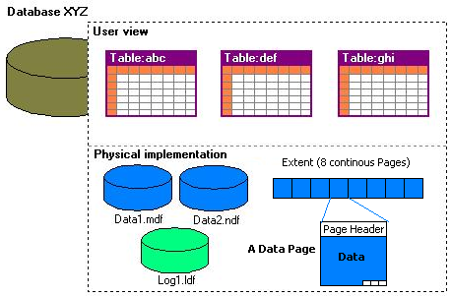
Structure of a Database

Slide 6

Structure of a Data File

Slide 7
Structure of a Page
Pages are the structures that contain all data that is not text or image
Pages have a fixed size of 8 KB, or 8192 bytes
Three major components of a page…
  The Page Header – contains header information for a page including pointer to next page, object stored in this page etc
  Data Rows – contains the actual data rows
  The Row Offset Array - blocks of 2-byte entries indicating the offset of data rows inside the page. This is used to track each and every row in a page

Slide 8
Structure of a Page
Page header
96
bytes
Row A
Row C
8,096
bytes
Data rows
Row B
C
B
A
Row offset table
2 bytes each

Slide 9
Types of Pages
Data Pages - All user data, except for the text, ntext, and image datatypes, are stored on data Pages
Text/image Pages - Data stored as text, ntext and image datatype
Index Pages - Pages stored in B-tree format for fast access
Page free space (PFS) Pages - keeps track free pages in a database
Global allocation map (GAM AND SGAM) - Allocation Pages keep track of the uniform and mixed extents
Index allocation map (IAM) Pages
Bulk changed map Pages and Differential changed map Pages - Both are used to make backup and recovery more efficient

Slide 10
Types of Extents
Mixed
extent
Uniform
extents
Free
space

Slide 11
Next Section>>>
Data Page – Exhaustive Study
Topics…
Page Header | Data Rows | Row Offset Array | DBCC PAGE | A Sample Page

Slide 12
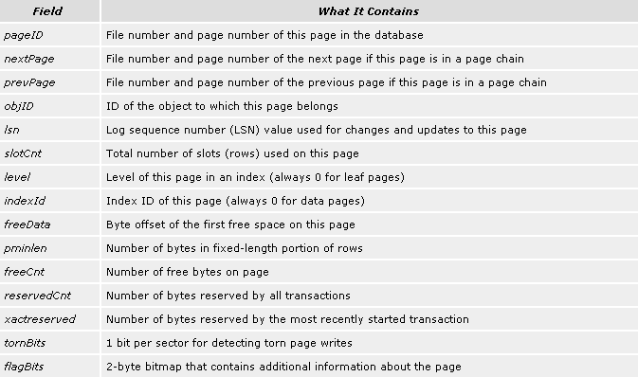
Page Header
Sample Page Header

Slide 13
Data Rows
Table's actual data rows are stored
A data row can't span multiple pages – exceptions are the text and image data types
The number of rows stored on a given page will vary depending on the length of a row
Maximum size of a row will be 8060 bytes
Variable-length rows will store as many rows as will fit based on the actual length of the data entered
Keeping row length shorter allows more rows to fit on a page, thus reducing I/O and improving the cache-hit ratio

Slide 14
Row Offset Array
The row offset array is a block of 2-byte entries
Indicates the offset on the page on which the corresponding data row begins
This information aren't stored in the row along with the data
The row offset array indicates the logical order of rows on a page
This mean that the rows will not be physically stored on the page in the order of the clustered index key
SQL Server uses the combination of file number, page number, and slot number on the page to uniquely identify each row in a table

Slide 15
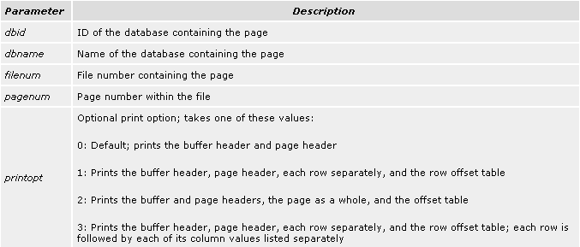
Examining Pages with DBCC PAGE
DBCC PAGE ({dbid | dbname}, filenum, pagenum[, printopt])
Note: DBCC TRACEON(3604) instructs SQL Server to return the results to the client instead of to the error log

Slide 16
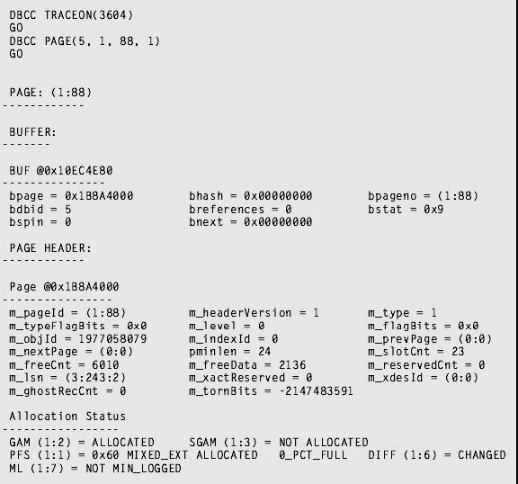
A Sample Page – “Page Header”
Page Header Contents

Slide 17
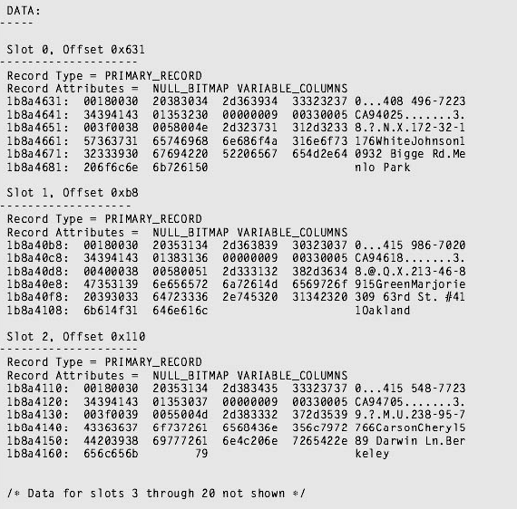
A Sample Page – “Data Rows”
The DATA section contains information for each row
For each row, DBCC PAGE indicates the slot position of the row and the offset of the row on the page
The page data is then divided into three parts The left column indicates the byte position within the row where the displayed data occurs
The next four columns contain the actual data stored on the page, displayed in hexadecimal
The right column contains a character representation of the data

Slide 18
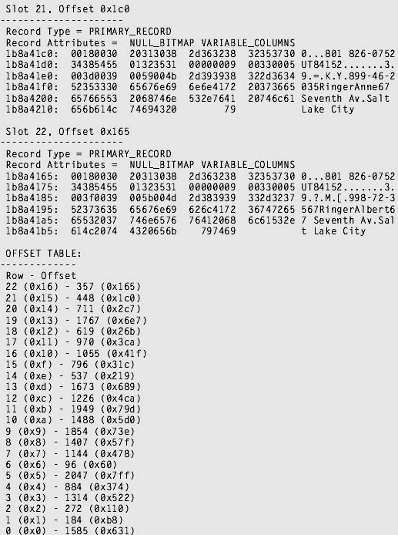
The OFFSET TABLE section shows the contents of the row offset array at the end of the page
The figure shows…
This page contains 23 rows, with the first row (indicated by slot 0) beginning at offset 1585 (0x631)
The first row physically stored on the page is actually row 6, with an offset in the row offset array of 96
DBCC PAGE displays the rows in slot number order

Slide 19
Next Section>>>
How SQL Server stores Data
Topics…
Storing Data/Text/Image Rows | Structure/Description of a Data Row | Managing Table Storage

Slide 20
Storing a data row in a page
Data
Header
Fixed data
NB
VB
Variable data
Null
block
Variable
block

Slide 21
Storing text and image Data in a page
Data row
Text
pointer
Root structure
Intermediate node
Intermediate node
Block 1
Block 2
Block 1
Block 2

Slide 22
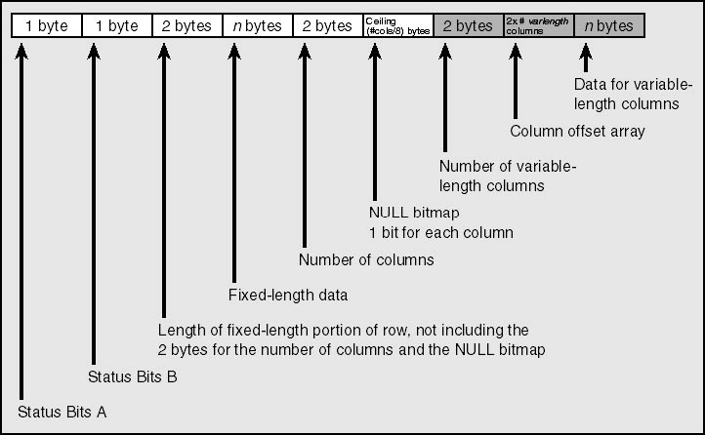
Structure of a Data Row

Slide 23
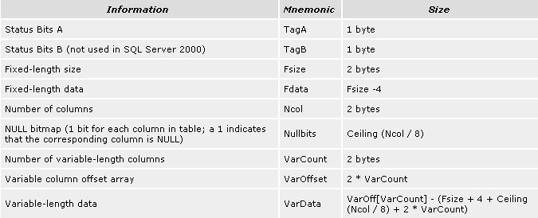
Description of a Data Row
Within each block of fixed-length or variable-length data, the data is stored in the column order in which the table was created

Slide 24
Managing table storage in system tables
When a table is created, one or more rows are added to the sysobjects, sysindexes, and syscolumns system catalogs (tables)
Name, Object ID, type and owner of the new table is added to the sysobjects table
The syscolumns table gains one row for each column in the new table, and each row will contain information such as the column name, data-type, and length
When you define the new table with one or more foreign key constraints, rows are added to the sysreferences system table
When a table is created, the sysindexes table will have one row that will contain pointers to the storage space

Slide 25
Managing table storage in system tables
No space is allocated until the first row is inserted
If the table has no rows, the columns first and reserved in sysindexes will be 0
If the table is defined without any primary key or unique constraints, sysindexes will have only one row, with an indid (index ID) value of 0, which means that the table is a heap
A clustered index will have an indid value of 1
Non-clustered index will have an indid value between 2 and 250, where as the text or image data will have an indid of 255

Slide 26
Next Section>>>
How SQL Server reads data
Topics…
Buffer Manager | Logical and Physical Reads | Example

Slide 27
Reading Data from Disk
SQL Server requests a page to the buffer manager
Buffer manager, which serves up the pages, knows whether a page is already in cache or must be accessed from disk and brought into cache
There are two reads that can happen
Logical Read – If the pages are retrieved from the cache via a request to the buffer manager
Physical Read - If the pages are not already in the cache, buffer manager brings it from the disk
cache-hit ratio – (I/O already in the cache) / (logical I/O)
Logical I/O – (Pages in Cache/Pages that are accessed from disk)

Slide 28

How Data is read from Disk
Buffer Manager
C
7
E
A
3
D
1
8
H
D
F
H
B
G
F
E
A
6
4
2
C
8
7
8
6
7
1
6
1
5
2
5
2
4
3
4
3
G
5
B
Memory buffer cache pages
Local database
C
I/O buffer
64 KB, 8 KB increments
1
E
2
A
3
D
4
F
5
H
6
G
7
B
8

Slide 29
Next Section>>>
Exercises
Topics…
Reading System Tables | Reading Pages | Exercises for you

Slide 30
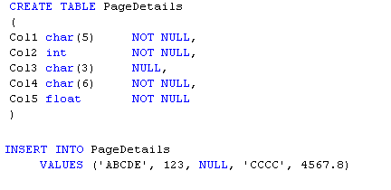
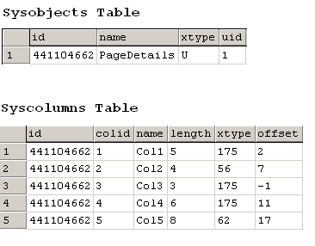
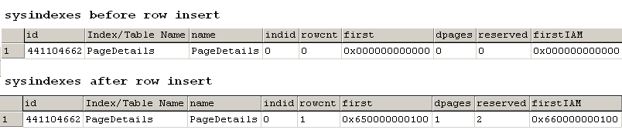
Exercise 1 – Reading System Tables

Slide 31
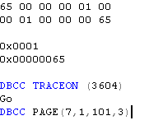
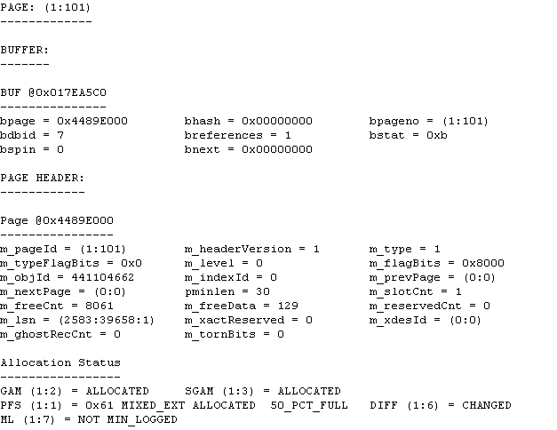
Exercise 2 – Reading Pages

Slide 32
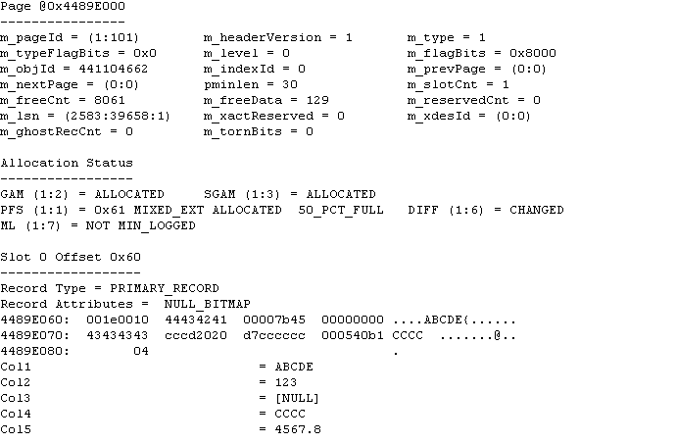

Exercise 2 – Reading pages

Slide 33
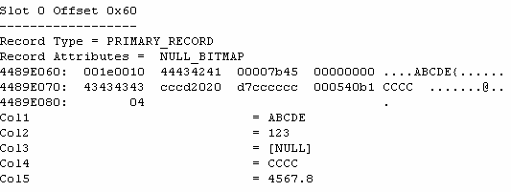
Exercise for you…
Can you decode this row value?

Slide 34
End of Topic – Storage Concepts
?

Slide 35
End of Topic – Storage Concepts
Thank you
Next Topic
Architecture Components | Storage Concepts | Transaction Logs | Indexes I | Indexes II | Locks I | Locks II | Query Processor

